Slide 1

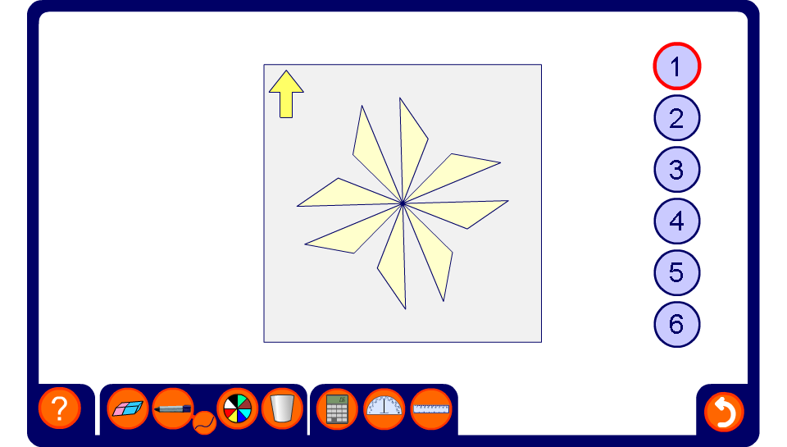


Finding the order of rotational symmetry
Notes:
Use this activity to show how we can find the order of rotational symmetry using tracing paper.
Explain that if we draw an arrow to indicate the top of the paper before we start, then we can tell when we’ve completed a full turn.
For each shape, turn the paper through 360º and count how many times the shape on the tracing paper coincides with the shape underneath. This number is the order of rotational symmetry. Warn pupils not to count the first position twice.
If the order of rotational symmetry is one, then the shape does not have rotational symmetry.
Ask pupils if any of the shapes have line symmetry.

